Slide 1

KISAN
EMPOWERING INDIA’S FARMERS

Slide 2
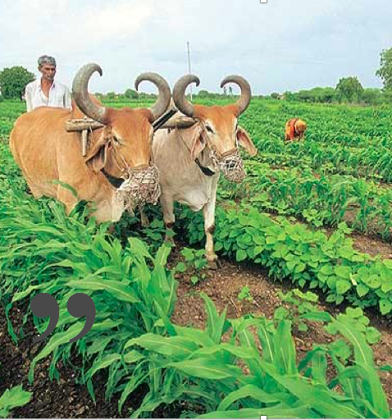
“
Hail the soldier! Hail the farmer!
“

Slide 3


Slide 4
56 % of the workforce

Slide 5
80% of the food

Slide 6


Slide 7


Slide 9
Tech Stack

Slide 10
People
TEAM
ALSO
Tanay Choudry
Haseeb Rabbani
Raiden
Ryan Angilly
Stephen Turex
Rajath Bhat

